Slide 1


Are You (User) Experienced? An overview of User Experience (UX) Design
Adam Freed, Principal and UX Consultant

Slide 2
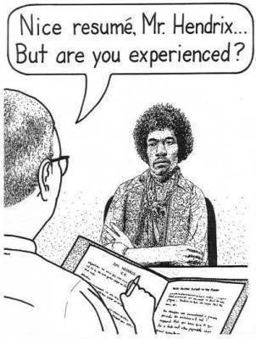
Experience

Slide 3

User Experience

Slide 4


Who am I?

Slide 5

Who are you?

Slide 6

A Brief History of UX

Slide 7
Historical Timeline
Typography, Sketching,
Industrial Design
1452-1519
Da Vinci
Design of Military Equipment
1939-1945
“Human
Factors”
Elements
of User
Experience
2002
JJG
IA
User Researcher
Interact’n Designer
Product Designer
Product Designer
~1970
Microprocessor,
Information Architecture
“UX”
1984
Don Norman
Vitruvian Triad
80-15BC
Vitruvious
*Courtesy of Cornelius Rachieru
Notes:
Vitruvious – De architectura (great book on roman architecture and machines), found during renaissance prompted birth of new architecture, design, science
Jesse James Garrett – helped define the role of a UX designer by analyzing the techniques

Slide 8
A Definition of Human Factors
“…the understanding of interactions among humans and other elements of a system, and the profession that applies theory, principles, data and methods to design in order to optimize human well-being and overall system performance.
…contribute to the design and evaluation of tasks, jobs, products, environments and systems in order to make them compatible with the needs, abilities and limitations of people..”
-HFES

Slide 9
A Definition of Information Architecture
“Information architecture is the practice of deciding how to arrange the parts of something to be understandable.
UX designers practice IA everyday; the two are closely connected. Put simply, IA is an important skill within UX and other disciplines…”
-IAI

Slide 10
A Definition of UX
“…cover all aspects of the person’s experience with the system including industrial design, graphics, the interface, the physical interaction, and the manual.”
-Don Norman

Slide 11
A Definition of Usability
“The extent to which a product can be used by specified users to achieve specified goals with effectiveness, efficiency and satisfaction in a specified context of use.”
-ISO 9241-11

Slide 12
Another Definition of Usability
“After all, usability really just means that making sure that something works well: that a person of average (or even below average) ability and experience can use the thing - whether it's a Web site, a fighter jet, or a revolving door - for its intended purpose without getting hopelessly frustrated.”
-Steve Krug

Slide 13
A Definition of User Centred Design
“User Centred Design (UCD) is an approach that supports the entire development process with user-centred activities, in order to create applications which are easy to use and are of added value to the intended users.”
-Usabilitynet.org

Slide 14
A Definition of Human Centred Design
“Human-centered design is characterised by: the active involvement of users and a clear understanding of user and task requirements; an appropriate allocation of function between users and technology; the iteration of design solutions; multi-disciplinary design.”
-ISO 13407

Slide 15
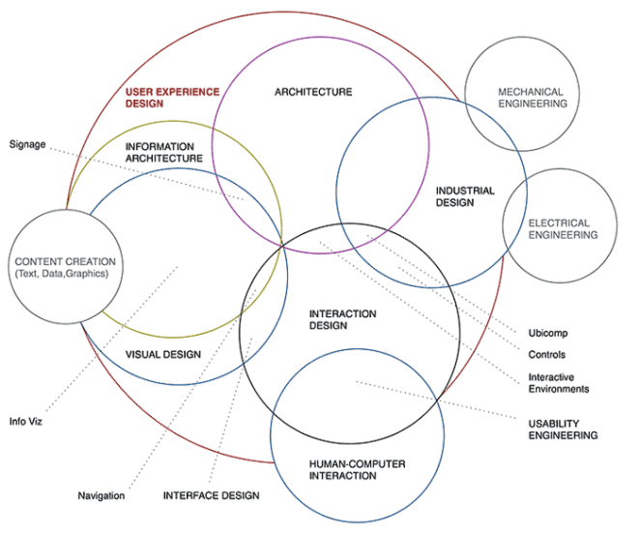
UX - A Multidisciplinary Field
*Courtesy of uxbeginner.com
Notes:
Speak to the backgrounds of people in the field

Slide 16
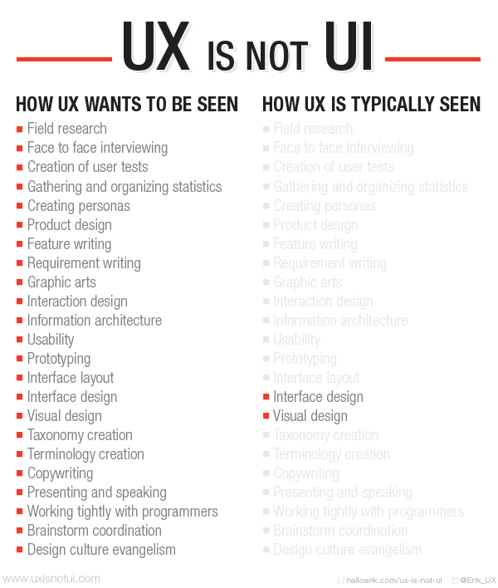
*Courtesy of uxisnotui.com
Notes:
Speak about early implementation vs tacking things on in a UI

Slide 17

The Keys to UX
Evidence Based
Measureable
Involves End-Users Throughout Process

Slide 18
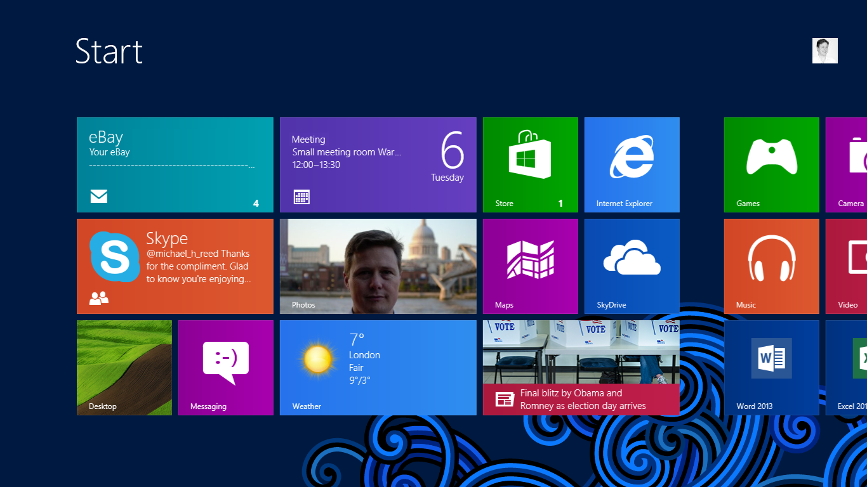
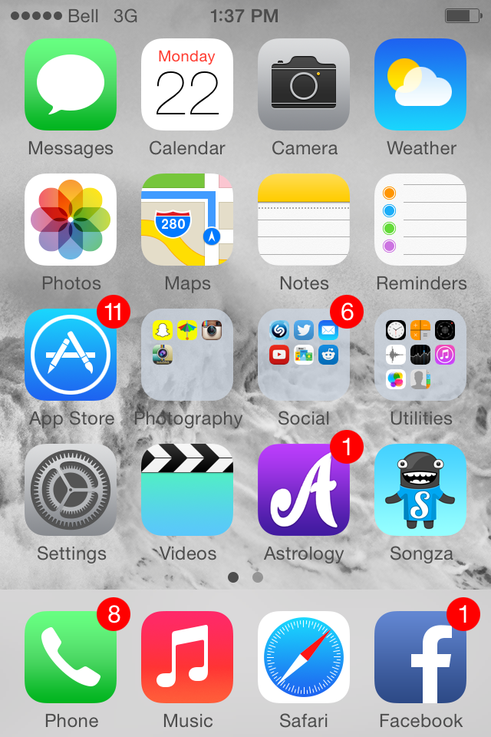
Poor User Experience vs Good User Experience
Notes:
Discuss some reasons for Windows 8 failure and success of iPhone interface

Slide 19

User Experience Economics
Good user experiences will result in:
Increased productivity
Reduced training costs
Preventable user errors
Reduced employee turnover
User satisfaction
Repeat business

Slide 20
Increased Productivity
2500 employees
X 10 transactions per day
X save one minute per transaction
X 10 years
= 550 person years savings
At $30,000 salary, that is a savings of $16,500,000

Slide 21
Preventable User Errors
2500 Employees
X avoid 200 errors per year
X 10 minutes per error
X 10 years
= 5,000,000 preventable errors
or 434 person years
Savings = $13,020,000

Slide 22
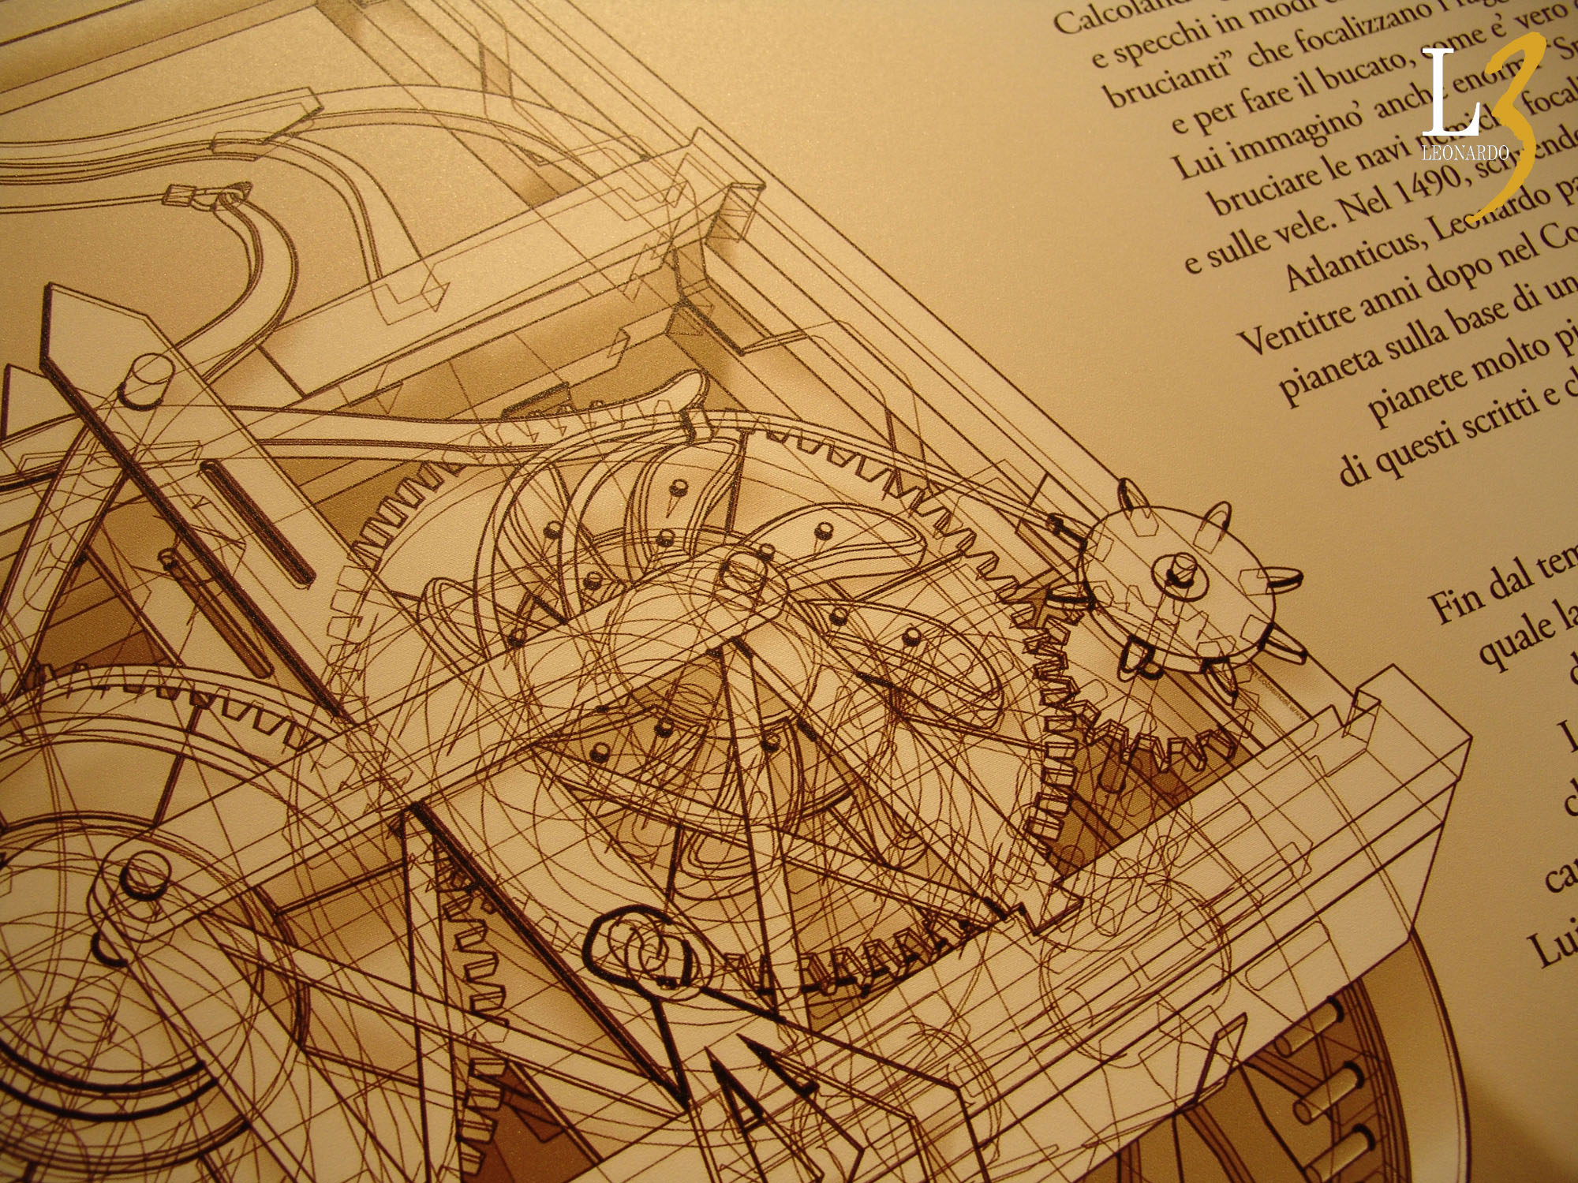
So How is this Accomplished?

Slide 23

Typical UX Process
Plan
COMPLETE
Test
Research
Design

Slide 24
The Planning Process
Stakeholder meeting
Context of use
Define usability goals
Competitive analysis
Notes:
Stakeholder meeting: strategic way to derive usability objectives from business objectives and gain commitment to usability
Why system being developed? Objectives? How judge success? Context, usability goals, Key functionality, etc.
Competitive analysis: online reviews, adverse event reports, heuristic analysis (more later on that)

Slide 25

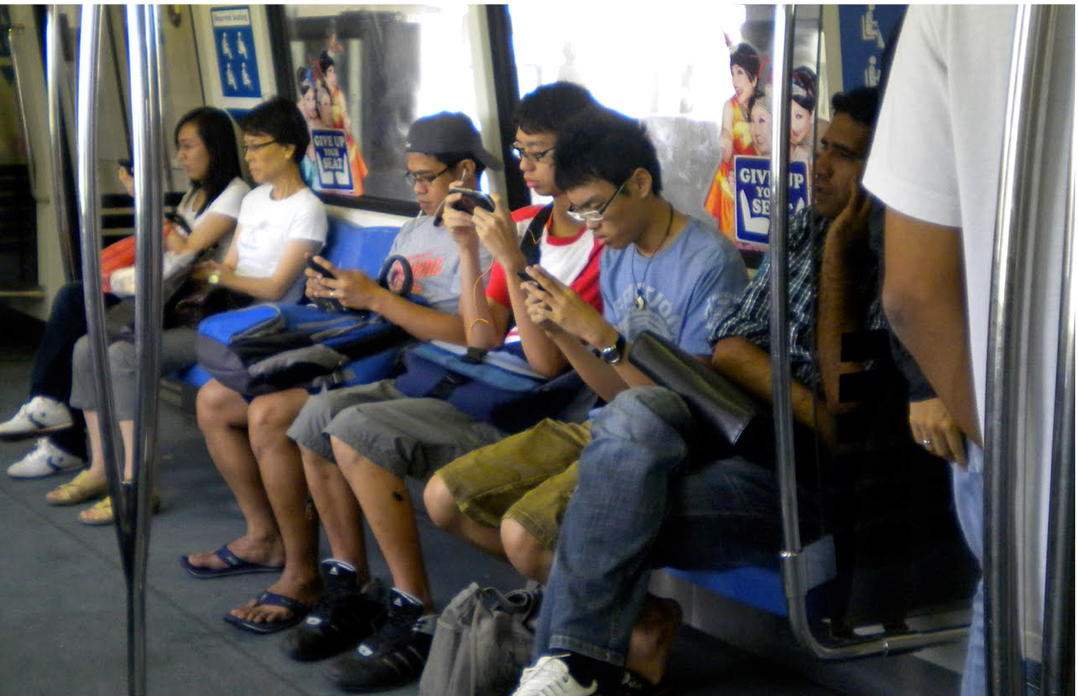


The Planning Process
Stakeholder meeting
Context of use
Define usability goals
Competitive analysis
Notes:
Images 1, 2: Technical and environment constraints
Images 3, 4: Who and how

Slide 26


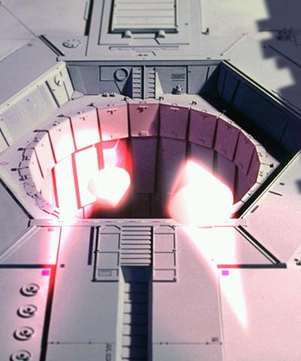

The Planning Process
Stakeholder meeting
Context of use
Define usability goals
Competitive analysis
Notes:
1: Speed: how long to complete a task
2: Accuracy: number of attempts to complete the task
3: Overall success: % who completed task
4: Satisfaction: How satisfied were users with the process of completing the task

Slide 27
User Research Techniques
Data gathering
Data analysis
Output
Notes:
Gather data directly from prospective end users
Analyse meaningfully to come up with conclusions
Output – requirements document containing complete range of primary and secondary users, prioritized list of requirements, measurable usability goals against which future designs can be tested, references to standards

Slide 28
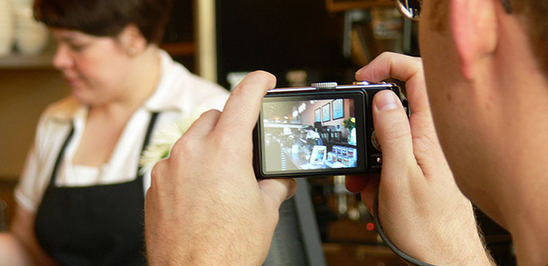

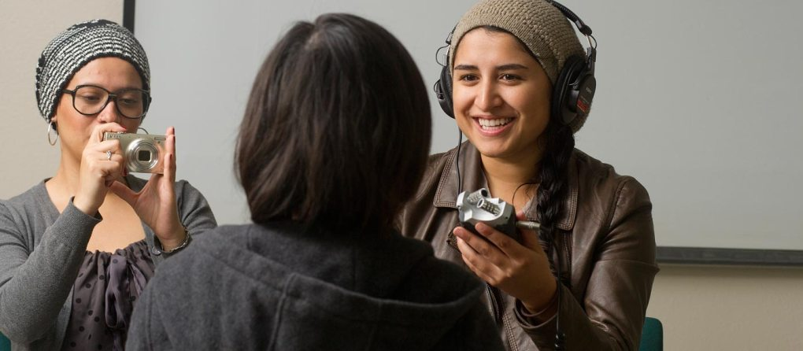
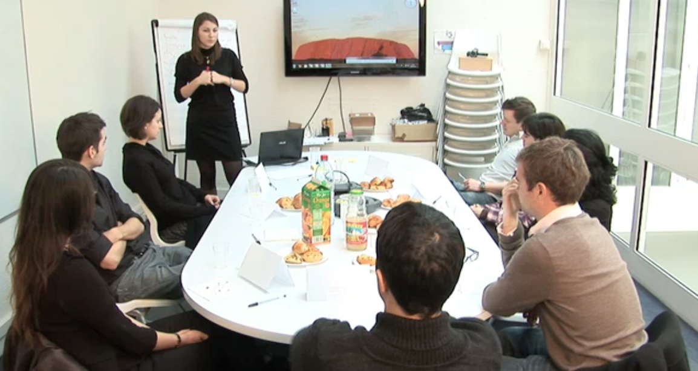
User Research Techniques
Data gathering
Data analysis
Output
Notes:
1: contextual observation
2: interviews
3: focus groups
4: surveys

Slide 29
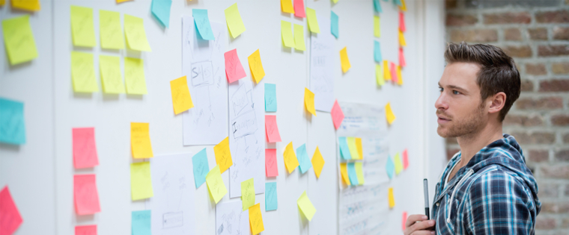
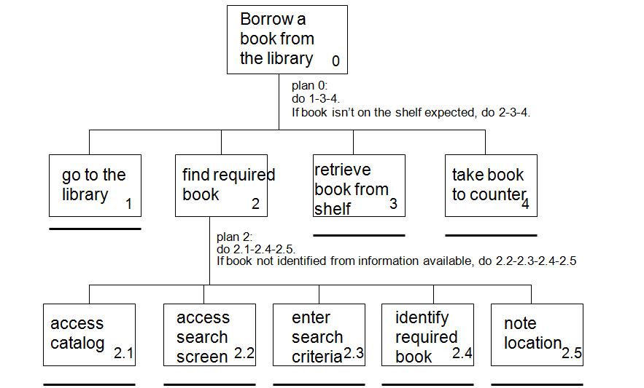
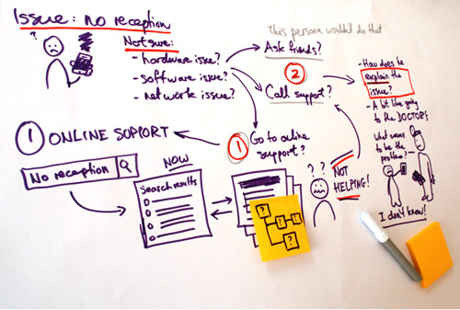
User Research Techniques
Data gathering
Data analysis
Output
Notes:
1: card sorting/affinity diagrams
2: hierarchical task analysis
3: storyboarding/use case/scenarios

Slide 30
Design Approaches
Prototype
Parallel design
Follow established guidelines/standards

Slide 31
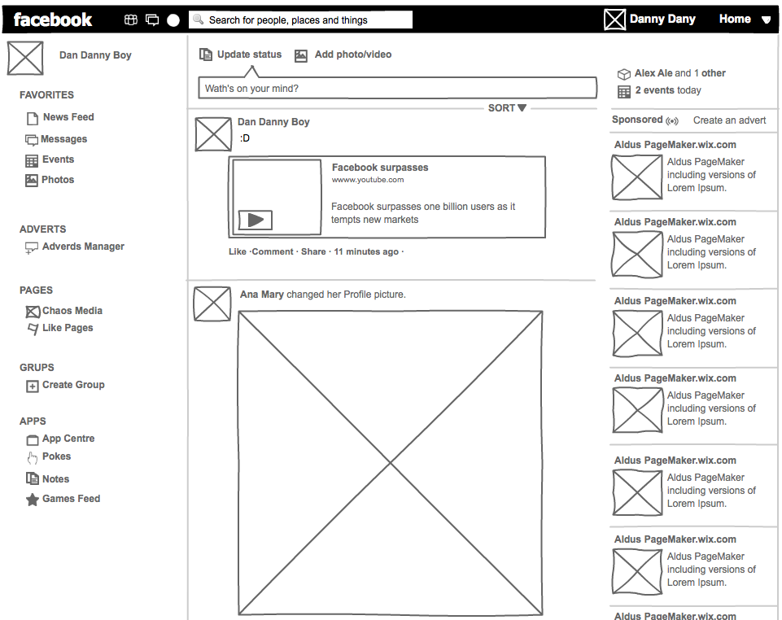
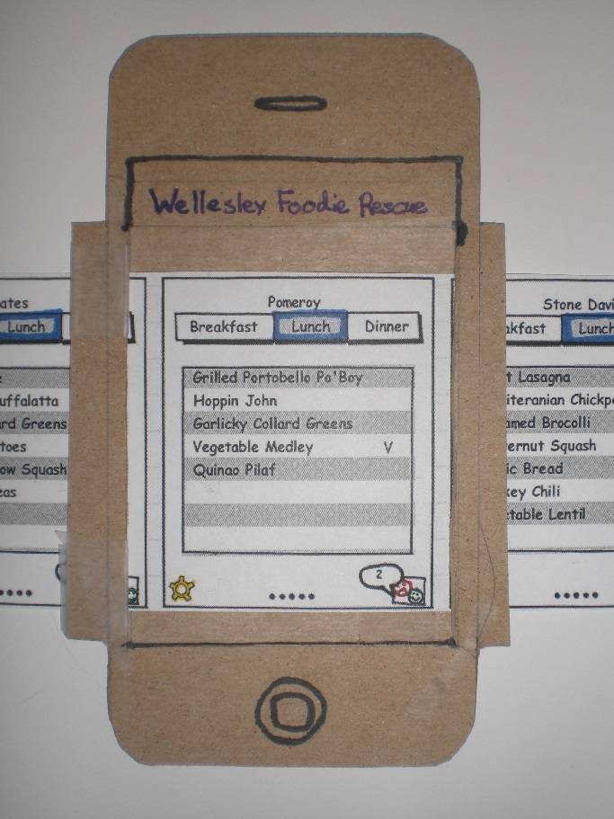


Design Approaches
Prototype
Parallel design
Follow established guidelines/standards
Notes:
1: paper prototype
2: wireframe
3: clickable prototype

Slide 32
Usability Testing
Formative vs summative
Test planning
Heuristic analysis
End-user testing

Slide 33
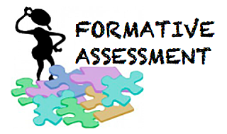

Usability Testing
Formative vs summative
Test planning
Heuristic analysis
End-user testing

Slide 34

Usability Testing
Formative vs summative
Test planning
Heuristic analysis
End-user testing

Slide 35
Usability Testing
Formative vs summative
Test planning
Heuristic analysis
End-user testing
How: Ad-hoc system use, looking for shortcomings in particular heuristics, such as:
Visibility of system status
Match between the system and the real world
Consistency and standards
Error prevention
Etc.
Who: Usability expert (1-3)
When: Summative or competitive analysis
What: Find general system usability issues
Where: Testing lab, office
Why: Show product readiness, determine competitive shortcomings

Slide 36
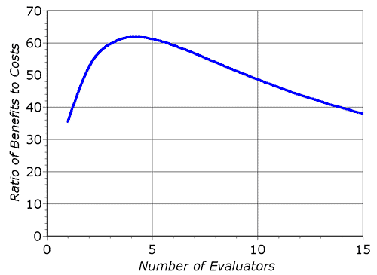
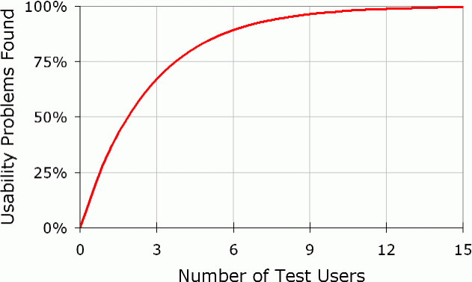
Usability Testing
Formative vs summative
Test planning
Heuristic analysis
End-user testing
Who: Actual end-users
Usability_Problems_Found(i) = N(1 – (1 – λ)^{i}),
Where i is the number of test users, N is the total number of usability problems in the system, and λ is the probability for finding any single problem with any single test user (Nielsen, 1993)
Usability_Problems_Found(i) = N(1 – (1 – λ)^{i}),
For a typical λ = 31%
*Charts courtesy of Nielsen

Slide 37
Usability Testing
Formative vs summative
Test planning
Heuristic analysis
End-user testing
How: Think aloud testing:
Various scenarios
Participant voicing thought process
Evaluator not leading
Includes questionnaire
When: Formative
What: Generally think aloud testing
Where: Testing lab, office
Why: Find usability problems

Slide 38
Usability Testing
Formative vs summative
Test planning
Heuristic analysis
End-user testing
How: Measurement testing:
Various scenarios
Participant uses system as they normally would
Evaluator generally observes
Measures can include: time to complete a task, number of tasks completed in a given time limit, number of errors, etc.
Includes questionnaire
When: Summative
What: Testing vs metrics
Where: Testing lab, office, in the field
Why: Assessing overall quality, ensuring system meets original usability goals

Slide 39
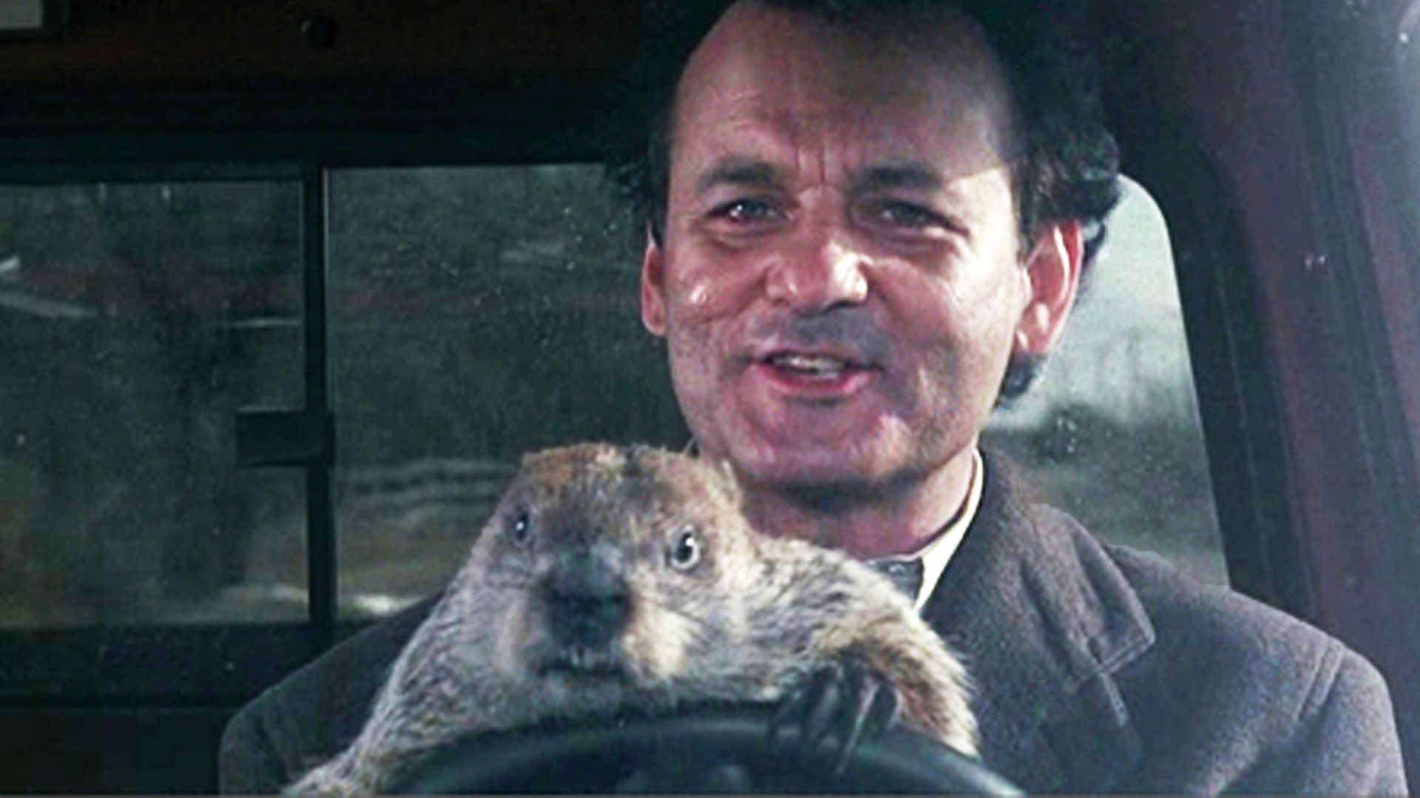
Iteration
Notes:
Speak to when to iterate and when to move to summative/completion

Slide 40
Takeaways
A designer is not (necessarily) a subject matter expert
The users know the answers, you have to know how to ask the questions
Early prototype, early (and often) test
Design to standards
Lather, rinse, repeat

Slide 41

Questions?

